Slide 1
CS2303: Systems Programming Concepts
Class 5
Kind and Scope of Variables
Xxx
Thanks to Prof. Lauer for an earlier version of some of these slides.
Copyright 2005-2017, Michael J. Ciaraldi

Slide 2
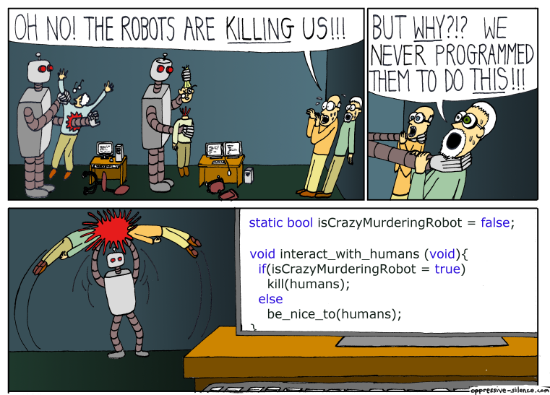
Importance of Proper Syntax

Slide 3
Reading Assignment
Chapter 5 of Kernighan & Ritchie
In Absolute C++
Arrays are discussed in Chapter 5!
Pointers are discussed in Chapter 10!
Underlying principles are exactly the same in C & C++

Slide 4
Kind and Scope of Variables

Slide 5
Kinds (Types) of Variables
Not double, char, etc.
What we are talking about now:
Where they are visible.
This is their scope.
C is lexically scoped, so you can tell just by reading the source code.
Where they are stored in memory.
When they come into existence, and when they go away.
This is their lifetime.

Slide 6
Kinds of Variables: Where Visible
Local variables
Declared within a function or block.
Visible there and (lexically) farther in.
Makes development easier.
Global variables
Visible to all functions and blocks.
Usually a very bad idea!
Somewhere in-between.
Visible to some functions.
“static” within a source file—more later.

Slide 7
Scope of Variables
Visibility:
Globals visible everywhere.
Locals visible inside their defining block.
Starting at the point each is defined.
In case of name conflict—they mask outer blocks.
Note: Return values get copied to the caller’s context.

Slide 8
Idiosyncrasies
In traditional C (& Visual Studio)
All variables must be declared at beginning of function or compound statement (i.e., before first statement); visible from that point on.
In gcc
Variables may be declared anywhere in function or compound statement; visible from that point to end of immediately enclosing block or function — i.e., ‘}’.
In C99 & C++
Loop variables may be declared in for statement; visible only within loop body, but not beyond.

Slide 9
Kinds of Variables: Where From
Automatic variables
Created when a function or block is entered.
Destroyed on exit.
Local variables and formal function parameters are automatic.
Stored on the stack.
Static variables
Always present.
Preserved between function calls.
In O-O, instance variables are preferred.

Slide 10
Typical memory organization
Automatic data lives here — allocated last-in, first-out
0xFFFFFFFF
stack
(dynamically allocated)
SP
address space
heap
(next week!)
global and static data
program code
(text)
PC
0x00000000
Global and static data lives here. Allocated by linker. Survives till end program.

Slide 11
Recursion
Every time a function is called, it gets a fresh set of local variables.
If it gets called again later, it is still a fresh set.
If it gets called recursively, each level gets its own separate set.

Slide 12
Static Data – Very different
Variables may be declared within or outside of functions
Storage allocated when program is initialized
Storage is released when program exits
Variables outside of functions are usually visible to linker
Unless you specify otherwise

Slide 13
Static Data – Very different
Compiler sets aside storage for all static variables at compile- or link-time
Values retained across function calls
Initializations must evaluate to compile-time constants

Slide 14
Confusion in terminology
Reserved word static in C & C++ programs does two things:
It makes the data static
According to previous definition (not auto)
Even if it already was static
It hides it from linker, …
… thereby making it invisible to other modules.
Variables declared outside of any function are called global
They are static variables without the word “static”!

Slide 15
Static Variable Examples
int j; //global, visible to linker &
// all functions in this program
static float f; // not visible to linker, visible to
// to all functions in this program
int fcn (float a, int b) {
// nothing inside of {} is visible to linker
int i = b; //automatic
double g; //automatic
static double h; //static, not visible to
// linker; value retained from call to call
…body – may access j, f, a, b, i, g, h…
} // int fcn( … )

Slide 16
Static Variable Examples
int j; //global, visible to linker &
// all functions in this program
static float f; // not visible to linker, visible to
// to all functions in this program
int fcn (float a, int b) {
// nothing inside of {} is visible to linker
int i = b; //automatic
double g; //automatic
static double h; //static, not visible to
// linker; value retained from call to call
…body – may access j, f, a, b, i, g, h…
} // int fcn( … )
Note: value of h is retained from one call to next
Value of h is also retained across recursions

Slide 17
Extern (Global) Variables
extern :– connected by linker to global of another program
int j; //static, visible to linker & all functs
static float f;// not visible to linker, visible to
// to all functions in this program
extern float p; // global, defined in another program;
// visible to linker
int fcn (float a, int b) {
// nothing inside of {} is visible to linker
int i = b; //automatic
double g; //automatic
static double h; //static, not visible to
// linker; value retained from call to call
body – may access j, f, a, b, i, g, h , p
} // int fcn( … )

Slide 18
Extern (Global) Variables (continued)
Examples:–
stdin, stdout, stderr are extern variables that refer to standard input, output, and error streams.
extern variables:–
Frequently occur in .h files.
Each must be actually declared outside any function in exactly one .c file.
With no special keyword, just the type.

